Slide 1
Gate-Level Minimization
Mano & Ciletti
Chapter 3

Slide 2
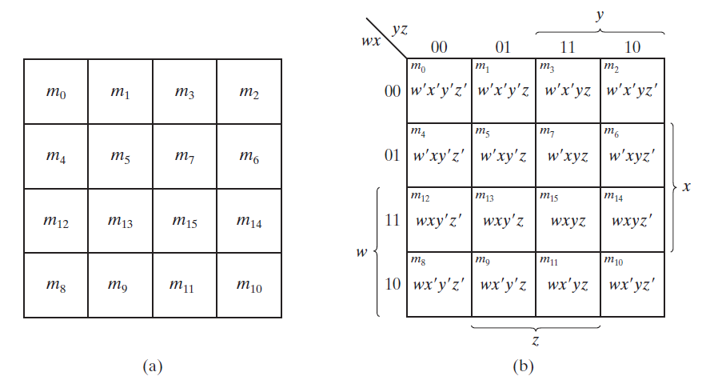
Four-Variable Map
16 minterms (and squares) for 4 variables.
Notes:
4 değişkenli Boolean fonksiyonları için Karnough Map şekildeki gibi gösterilebilir. Şekilden görüldüğü 16 adet minterm komşu karelere binary artış ile değil graysclae formatında yerleştirilmiştir.

Slide 3
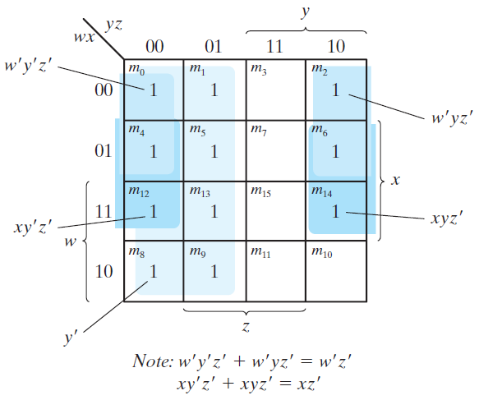
Example 5
Simplify F(w,x,y,z)=Σ(0,1,2,4,5,6,8,9,12,13,14)
  F(w,x,y,z)=y’+w’z’+xz’

Slide 4
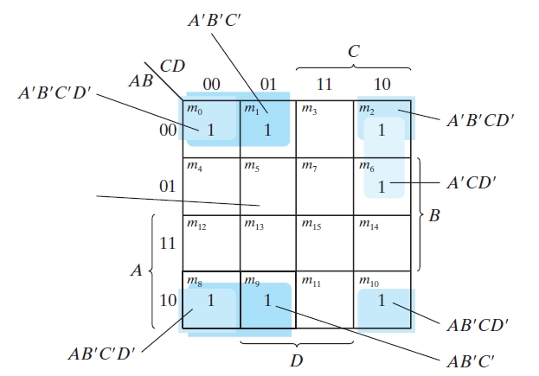
Example 6
Simplfy F=A’B’C’+B’CD’+A’BCD’+AB’C’
  F=B’D’+B’C’+A’CD”

Slide 5
Prime Implicant
A product term obtained by combining the max. possible number of adjacent squares.
If a minterm is covered by only one prime implicant, that prime implicant is said to be essential.

Slide 6
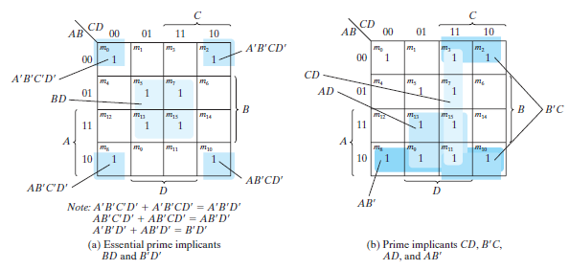
Example
F(A,B,C,D)=Σ(0,2,3,5,7,8,9,10,11,13,15)

Slide 7
Example
F=BD+B’D’+CD+AD=BD+B’D’+CD+AB’
=BD+B’D’+B’C+AD=BD+B’D’+B’C+AB’

Slide 8
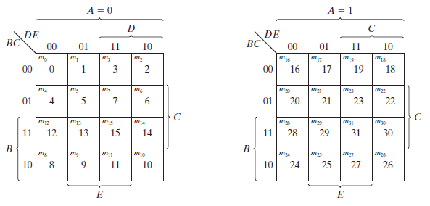
Five-Variable Map
Not simple, is not usually used. 5 variables, 32 squares.

Slide 9
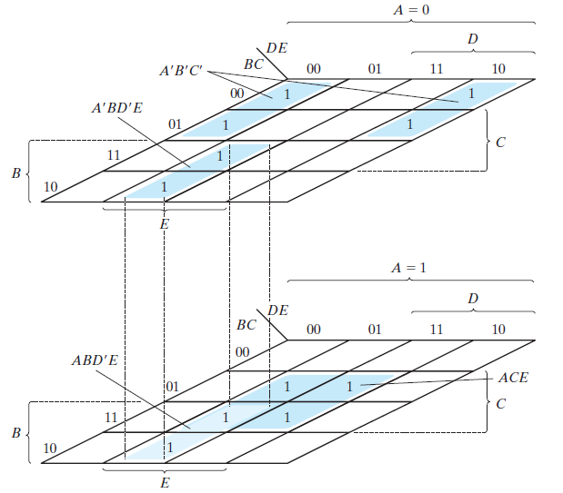
Example 7
Simplfy F(A,B,C,D,E)=Σ(0,2,4,6,9,13,21,23,25,29,31)
  F=A’B’E’+BD’E’+ACE

Slide 10
Product-of-Sums Simplification
Mark the empty squares by 0’s.
Combine them (as we did for sum-of-products)
  We obtain F’ (complement of the function)
Take the complement of F’ ((F’)’) to obtain F.

Slide 11
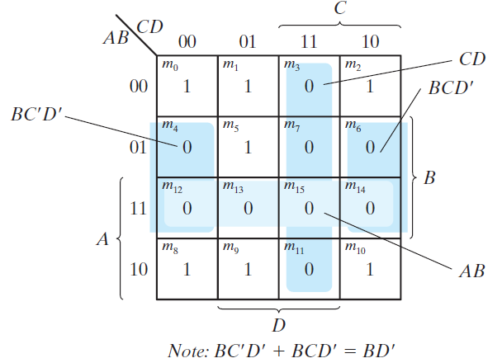
Example 8
Simplfy F(A,B,C,D)=Σ(0,1,2,5,8,9,10)
  F=B’D’+B’C’+A’C’D
  F’=AB+CD+BD’ => F=(A’+B’)(C’+D’)(B’+D)

Slide 12
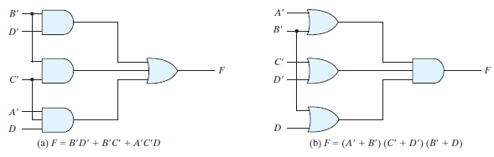
Example 8 gate impl.
Two different implementations of the same function.

Slide 13
Don’t Care Conditions
In practice’ some combinations are not specified as 1’s or 0’s.
  Four bit binary codes has six unused combinations.
Functions having unspecified outputs are called incompletely specified functions.
  We don’t care the unspecified minterms
  These minterms are called don’t-care conditions.
  They can be used for minimization.
  They are indicated as X’s in the map.
  They can be assumed as 1’s or 0’s to have best simplification.

Slide 14
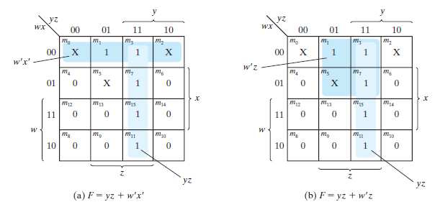
Example 9
Simplify F(w,x,y,z)=Σ(1,3,7,11,15) having don’t care conditions d(w,x,y,z)= Σ(0,2,5)

Slide 15
NAND and NOR Implementation
Generally used for circuit design
  Easier to fabricate.
  Basic gates
  Other functions can be generated from them.
  Rules have been developed to convert functions to NAND and NOR only implementations.

Slide 16
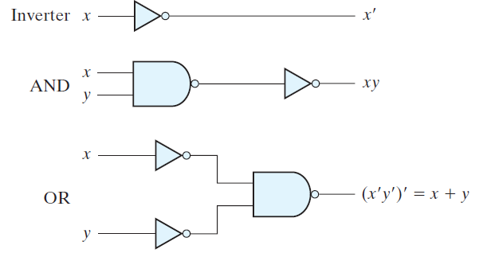
NAND Circuits
NAND gate is universal
  Any digital system can be implemented with it.
  AND, OR and NOT can be implemented with NANDs.

Slide 17
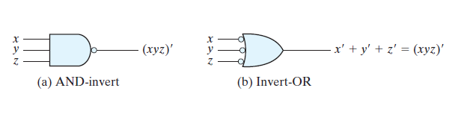
Two graphic symbols of NAND

Slide 18
Two-Level Implementation
Have the function in sum-of-product form.
Put bubbles (inverters) to have two different representations of NAND gate
  Either AND-invert or Invert-OR

Slide 19
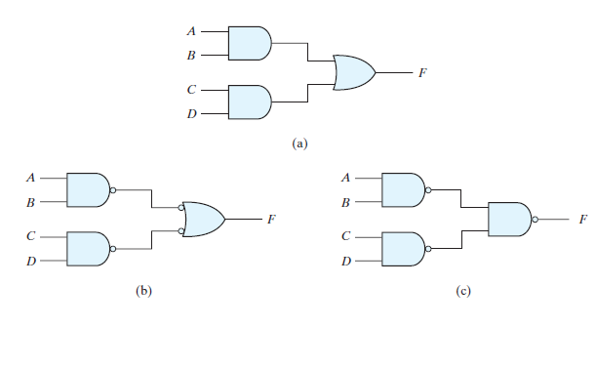
Example: F=AB+CD

Slide 20
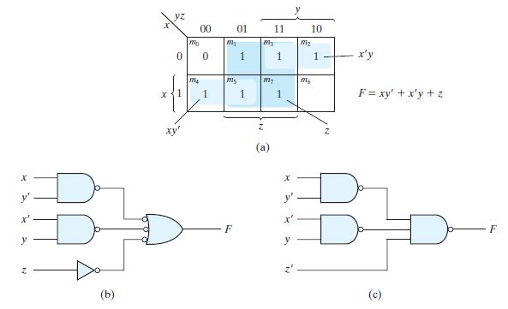
Example 10
Implement F(x,y,z)=Σ(1,2,3,4,5,7) with only NAND gates.

Slide 21
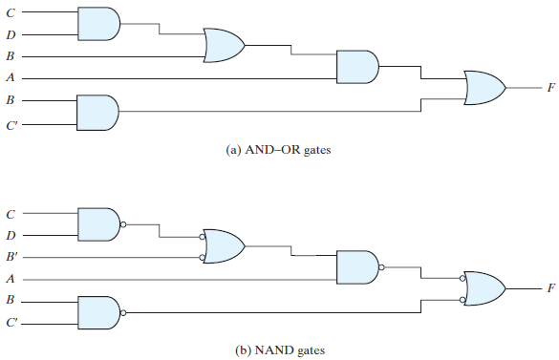
Multilevel NAND Circuits
F=A(CD+B)+BC’

Slide 22
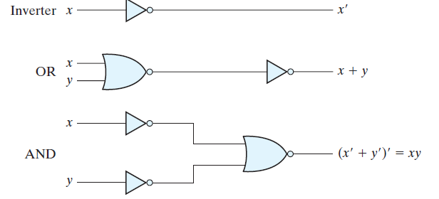

NOR Implementation
Dual of NAND operation

Slide 23
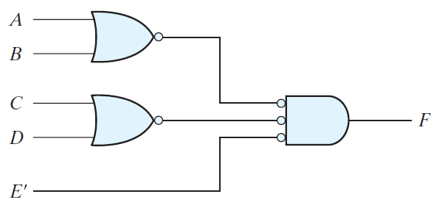
Example: F=(A+B)(C+D)E

Slide 24
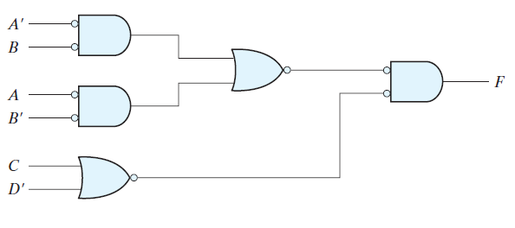
Example: F=(AB’+A’B)(C+D’)

Slide 25







Exclusive-Or (XOR) Function
XOR
  1 if only x is one or if only y is 1
XNOR
  1 if both inputs are 1 or both inputs are 0
Some identities of XOR

Slide 26
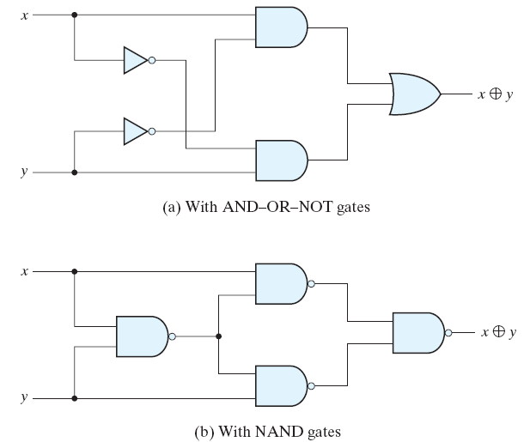
XOR Implementations

Slide 27
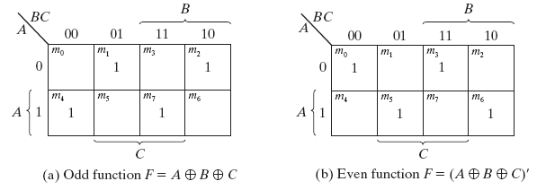
Odd Function
N variable XOR function is odd function defined as
  The logical sum of the 2^{n}/2 min-terms whose binary numerical values have an odd number of 1’s. If n=3, 4 min-terms have odd number of 1’s.

Slide 28
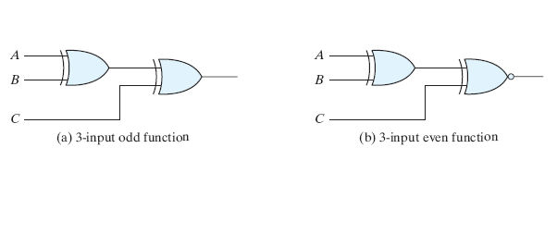
Logic Diagram of odd and even functions

Slide 29
Parity Generation
A parity bit is an extra bit included with a binary message
  If number of 1’s is odd, parity bit is 1; else 0.
The circuit that generates the parity bit in the transmitter is called parity generator.
Parity bit can be generated using XOR function.

Slide 30
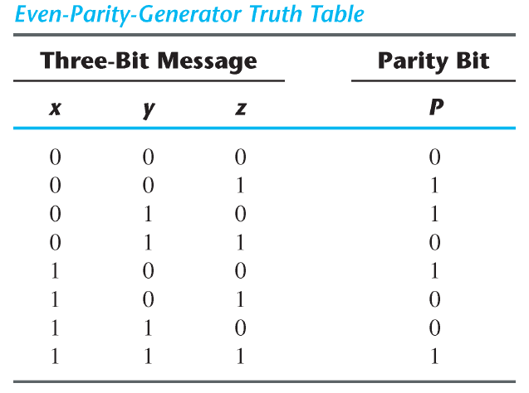
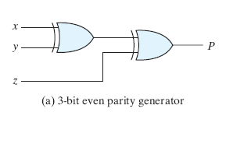
3-Bit Parity Generator

Slide 31
Parity Checker
Bits are transmitted to the destination with parity.
The circuit that checks the parity in the receiver is called a parity checker.
Parity checker can be implemented with XOR gates.

Slide 32
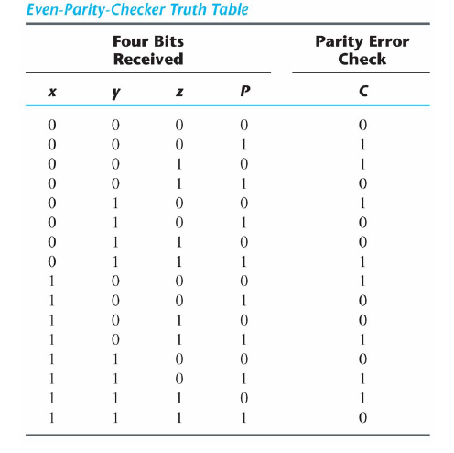
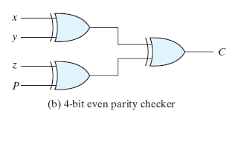
3-Bit Parity Checker

